Slide 1
Efficient information distribution in Internet of Medical Things (IoMT) scenarios
Tullia Fontana, Nicolás Ortiz De Zarate, Nicole Zattarin

Slide 2
Introduction
Problem:
Large amount of data
Fast processing
Limited capacity of communication networks
Trade-off:
Transmitted information – Channel saturation

Slide 3
Introduction
Correlations: Principal Component Analysis [2]
Dimensionality reduction: Kmeans Clustering [4]
Heterogeneous analysis: data of the same kind
Homogeneous analysis: data of different kind
Validation: binary classification task
Network design

Slide 4
Dataset
Dataset:
OPPORTUNITY Activity Recognition Dataset [1]
Termed activity of daily living (ADL) dataset:
Start: lie on the deckchair, get up
Groom: move in the room
Relax: go for a walk
Prepare/drink coffee
Prepare/eat sandwich
Cleanup
Break: lie on the deckchair

Slide 5

Dataset
Sensor types:
Inertial Measurement Units (IMU) accelerators and gyroscopes
Triaxial accelerometers
Pre-processing:
$$M=\sqrt{x^{2}+y^{2}+z^{2}}$$

Slide 6
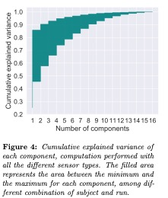
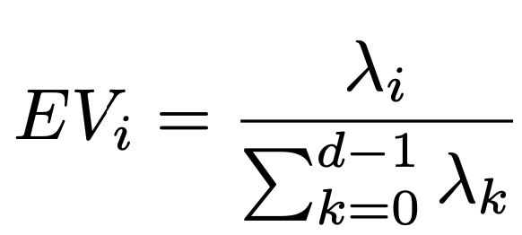
Correlations: Principal Component Analysis (PCA) [2]
Dimensionality reduction technique based on the correlation among features;
Principal Components (PCs): linear combination of original features;
Explained Variance: measurement of the percentage of variance which can be attributed to each of the PCs:

Slide 7
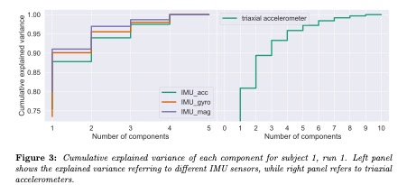
Correlations: Principal Component Analysis (PCA)

Slide 8
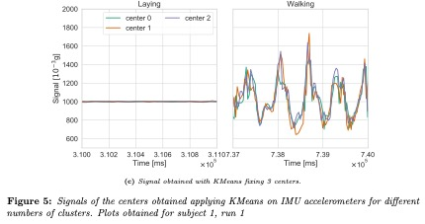
Dimensionality reduction: Clustering
Data: signals from different sensors while the subject is walking/laying;
Kmeans clustering [4] [5]: computes centroids with a fixed number of clusters;
Metrics: Euclidean, dynamic time wrapping distance [6];
Approach: apply Kmeans at each millisecond.

Slide 9
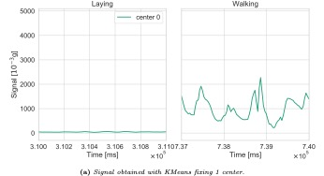
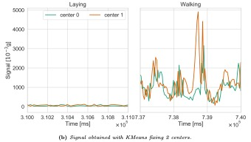

Dimensionality reduction: Clustering

Slide 10
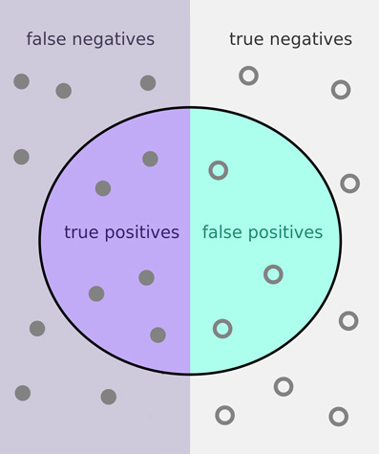
Validation: binary classification
How well can we still distinguish high level activity after clustering?
Train a binary classifier (walking/laying) on original features
Test on data obtained from the signals of KMeans centroids
Accuracy answers the question

Slide 11
Classification of homogeneous data
Dataset: amplitude of the signals in a window of 80 ms;
False positive rate: non negligible ~20%;
Linear model: logistic regressor
Figure: IMU accelerometer signals in laying conditions.

Slide 12
Classification of homogeneous data
Dataset: entire time-series;
Accuracy: high accuracy, diagonal confusion matrix;
Training: slower and more delicate;
Tuning: requires specific hyperparameters according to the specific kind of data;
Neural model:

Slide 13
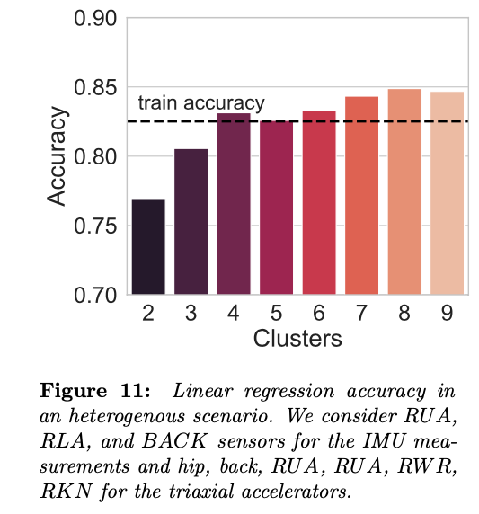
Classification of heterogeneous data
Dataset: RUA, RLA, and BACK sensors for the IMU measurements and hip, back, RUA^, RUA_, RWR, RKN_ for the triaxial accelerators;
Preprocessing: standardization among data coming form different sensors;

Slide 14
checkpoint
Homogeneous analysis:
IMU sensors (4 each): a single PC accounts for ~90% of variance → one cluster is enough to correctly classify with more than 95% accuracy;
Triaxial accelerometers (9 each): 2/3 PCs account for ~90% of variance → 2/3 clusters are needed to reduce the leak of (~93% accuracy).
Heterogeneous analysis:
PCA: ~8 components to account for the 90% variance for all runs/subjects;
Clustering and classification: more than 4 centers to reach train accuracy;

Slide 15
References

Slide 16
references

